Slide 1
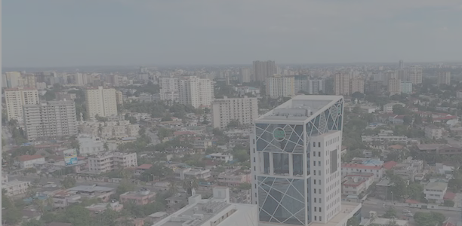
Smart
economy
Smart
mobility
Smart
energy
Smart
living
Project 7: ICT & SSIC – Towards a smart and
inclusive Dar es salaam by 2050
Smart
governa
nce
Smart
Environ
ment
Project Leaders: Rigobert Buberwa and Leo Van Audenhove
Notes:
Kop
9/24/21
Voet
1

Slide 2
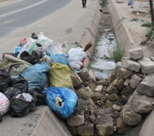
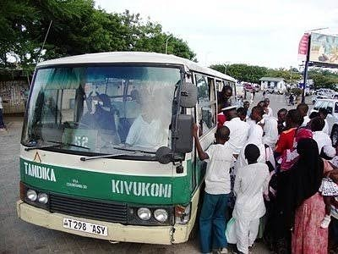
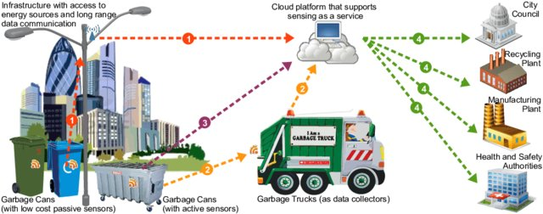
Background
Poor solid waste management practices
Poorly coordinated public transport
Smart City: Use of ICT towards improving operations, service delivery and welfare of citizens.
Problem: No digital strategy towards leveraging smart ICT.
Effect: Poor coordination, uninformed decisions, lack of inclusiveness
Opportunity: SSIC
Image Source: Perera et al. (2017). Fog Computing for Sustainable Smart Cities: A Survey
12/25/10
Pag.
2
2
Notes:
Kop
9/24/21
Voet
2

Slide 3
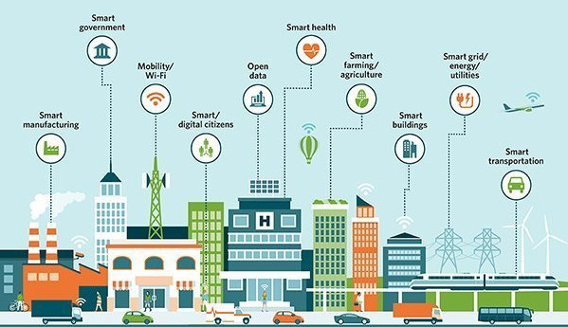
Challenge in Adoption of SSIC
Objective
Many building blocks: data sources, myriad of stakeholders.
No defined standards for: data exchange, open data governance.
No inventory on available capacity.
No framework for coordination of Smart City initiatives and policies for inclusiveness
12/25/10
Pag.
3
3
Notes:
Kop
9/24/21
Voet
3

Slide 4
Objectives
Objective
Main project objectives: to build fundamental research and strategic capacity on SSIC, to prototype smart sustainable city solutions supporting the different IUC projects and, to make ARU become a centre of excellence on SSIC initiative.
12/25/10
Pag.
4
4
Notes:
Kop
9/24/21
Voet
4

Slide 5
Specific objectives
Objective
Investigating the concept and underlying components of SSIC in a development context, …
Explore potential of smart technologies to achieve SDGs
Develop the specific expertise on data gathering, handling, analytics.
Provide transversal support for the different projects in the IUC on data-analytics and smart city solutions…
Develop and enhance ARU Capability in using ICT in its core operations.
Engage and stimulate (new) collaboration between key-stakeholders…
Research
Apply transversally
Transversal Tool
Outreach
12/25/10
Pag.
5
5
Notes:
Kop
9/24/21
Voet
5

Slide 6
Medium Term Achievements (Research, Training, and Outreach)
Medium term achievements
A vision and strategy for SSIC and its role within a development context with a specific focus on Dar Es Salaam
An understanding of the SSIC context – policy, infrastructure, user dynamics, ICT & gender and environment;
Developed collaboration models for the quadruple helix and build participatory policy making expertise at ARU ;
12/25/10
Pag.
6
6
Notes:
Kop
9/24/21
Voet
6

Slide 7
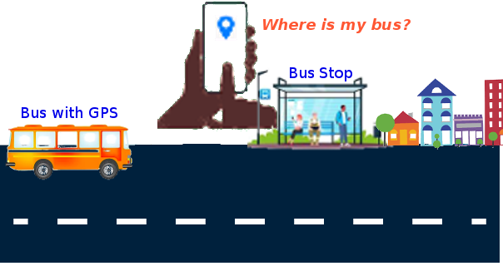
Medium Term Achievements (Transversal)
Medium term achievements
Researched and developed the necessary supporting data-infrastructures and data-analytics competences at ARU;
Developed digital transformation strategy for ARU including a blended learning programme at ARU in support of the institution and more specifically in support of education and outreach initiatives developed in the IUC projects;
Developed and evaluated prototypes of smart city solutions, and community engagement tools with all other IUC projects through Action Research;
12/25/10
Pag.
7
7
Notes:
Kop
9/24/21
Voet
7

Slide 8
Medium Term Achievements (Transversal)
Medium term achievements
Developed training programme on data-analytics for stakeholders and for staff working in the different IUC projects;
Developed outreach programme on SSIC for stakeholders in the quadruple helix.
12/25/10
Pag.
8
8
Notes:
Kop
9/24/21
Voet
8

Slide 9
Partners
Partners Belgium
Vrije Universiteit Brussel
Studies on Media, Innovation & Technology
KULeuven
Public Governance Institute
UGent
Directie ICT & Datacentre
PXL – University of Applied Sciences and Arts
PXL Digital
PXL Centre of Expertise SMART ICT
12/25/10
Pag.
9
9
Notes:
Kop
9/24/21
Voet
9

Slide 10
Possible additional partners
AP – University of Applied Sciences and Arts
ACTEA have shown interest
University of the Western Cape (South Africa)
CoLab for e-Inclusion and Society Innovation
Post Graduate Data Analytics
12/25/10
Pag.
10
10
Notes:
Kop
9/24/21
Voet
10

Slide 11
Phase in
Upgrade ICT infrastructure before start
ARU, UGent, PXL
Separate budget
Need to kick this off in short term
12/25/10
Pag.
11
11
Notes:
Kop
9/24/21
Voet
11

